Slide 1

User description id 96
Personal & purchases information

Slide 2
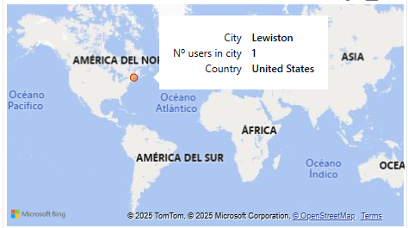
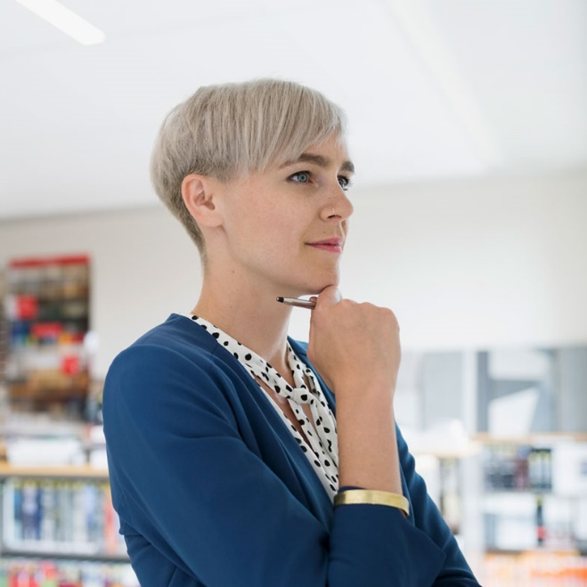



User information
Brennan Wynn
ID 96 | 37 years old
nullam.ut@yahoo.net
(831) 607 3574

Slide 3
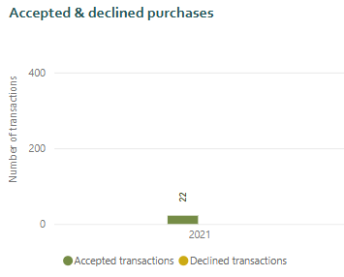

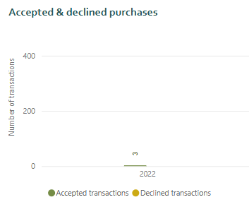

Total purchases
2021
2022

Slide 4
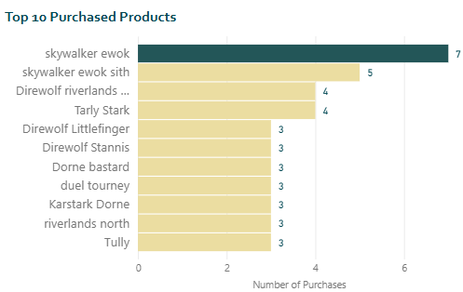
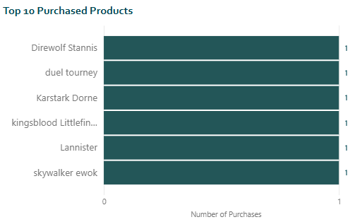
Purchased products – top 10
2021
2022

